Slide 1

SharePoint Saturday
Everything about SharePoint you didn’t want to know!!!
March 18, 2017
Kevin R. Grohoske

Slide 2

Who am I…Why am I here…
Kevin Grohoske (‘grow-has-ski’):
Sparkhound (Birmingham - AppDev Lead)
Experience:
+20 years experience
Fortune 500 companies
US Army
Education:
Info Systems & MBA
Contact:
(205) 235-1021
kevin.grohoske@sparkhound.com
Notes:
Database types and descriptions in SharePoint Server 2016 - https://technet.microsoft.com/en-us/library/cc678868(v=office.16).aspx
“Before we get started” Questions:
How many are:
SQL Folks
App Dev
SharePoint
Consider yourself Business Users
I’m going to highlight some things I have encountered…
Talk about Legacy, Current, and Future Directions

Slide 3
SharePoint Databases
List of all SharePoint Databases:
Configuration (SharePoint_Config)
Central Administration Content (SharePoint_AdminContent)
Content (WSS_Content)
App Management (AppMng_Service_DB)
Business Data Connectivity (Bdc_Service_DB)
Search Administration (Search_Service_Application_DB)
Analytics Reporting (Search_Service_Application_AnalyticsReportingStoreDB)
Crawl (Search_Service_Application_CrawlStoreDB)
Notes:
Database types and descriptions in SharePoint Server 2016 - https://technet.microsoft.com/en-us/library/cc678868(v=office.16).aspx

Slide 4
SharePoint Databases
List of all SharePoint Databases
Link (Search_Service_Application_LinkStoreDB)
Secure Store (Secure_Store_Service_DB)
Usage (WSS_Logging)
Subscription Settings (SettingsServiceDB)
User Profile (User Profile Service Application_ProfileDB)
User Synchronization (User Profile Service Application_SyncDB)
User Profile Social Tagging (User Profile Service Application_SocialDB)

Slide 5
SharePoint Databases
List of all SharePoint Databases
Word Automation (WordAutomationServices)
Managed Metadata Service (Managed Metadata Service)
SharePoint Translation Services (TranslationService)
PowerPivot Service (DefaultPowerPivotServiceApplicationDB)
PerformancePoint (PerformancePoint Service Application)
State Service (StateService)
Report Server Catalog (ReportingService)
ReportServerTempDB (ReportingService_<GUID>_TempDB)
Report Server Alerting (ReportingService_<GUID>_Alerting)

Slide 6
SharePoint Databases
SharePoint Databases – all have their own unique features SQL guidance:
Location requirements
General size information and growth factors
Read/write characteristics
Default recovery model
Supported backup tools
Recommended scaling method
Technet Database types and descriptions:
https://technet.microsoft.com/en-us/library/cc678868(v=office.16).aspx
Notes:
Database types and descriptions in SharePoint Server 2016 - https://technet.microsoft.com/en-us/library/cc678868(v=office.16).aspx

Slide 7
Virtualization Considerations
To Virtualize or Not:
Web and Application Servers:
Performance Considerations:
Host OS Resources
Physical NICS Virtual NICS
SQL Server:
Bottom Line
“…a virtual database server will not outperform a physical server that uses the same configuration. However, if you scale up the virtual database server configuration, you can achieve the same overall throughput at a slightly increased CPU usage cost”
Notes:
Overview of farm virtualization and architectures for SharePoint 2013 - https://technet.microsoft.com/en-us/library/ff607811.aspx

Slide 8
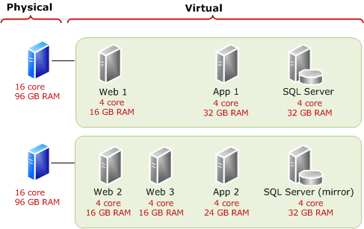
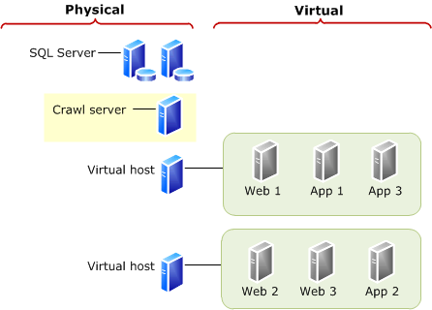
Virtualization Considerations
Notes:
Overview of farm virtualization and architectures for SharePoint 2013 - https://technet.microsoft.com/en-us/library/ff607811.aspx

Slide 9
SharePoint Blob Storage
#1 pain of mature SharePoint implementations is storage (as you all likely know already)
Separates structured & unstructured data
Maximizes cost effective storage (only purpose)
2 Types:
Local RBS
Filestream (free)
Remote RBS
AvePoint Storage Manager ($)
Mexalogix StoragePoint ($)

Slide 10
SharePoint Blob Storage
Noteworthy SharePoint Server 2016 points:
BLOB Store installation package for SQL Server 2014 is the only version of local RBS supported.
Site collection backup and restore will download the file contents and upload them back to the server (deep copy).
The FILESTREAM provider is the only provider that is currently supported for SharePoint Server 2016 farm database backup and restore operations.
Backup and restore in Central Administration — cannot be used with “remote RBS providers”.
Notes:
Overview of RBS in SharePoint Server 2016 - https://technet.microsoft.com/en-us/library/ee748649(v=office.16).aspx
Deciding to use RBS in SharePoint Server 2016 - https://technet.microsoft.com/en-us/library/ff628583(v=office.16).aspx

Slide 11
SharePoint Diagnostic Logging
Another cost effective way to save OS disk space
Configure/Tune Diagnostics Settings
Restrict log disk space usage
Use the Verbose setting sparingly
Enable event log flooding protection
Move the logs off the machine
Notes:
Overview of RBS in SharePoint Server 2016 - https://technet.microsoft.com/en-us/library/ee748649(v=office.16).aspx
Deciding to use RBS in SharePoint Server 2016 - https://technet.microsoft.com/en-us/library/ff628583(v=office.16).aspx

Slide 12
SharePoint Monitoring
Proactive Monitoring
System Center Management Pack for SharePoint Server
Metalogix - Diagnostic Manager
Reactive Monitoring
Health Analyzer
Reports
Availability Monitoring
Angry Users w/ pitchforks and lanterns
Notes:
Overview of Monitoring - https://technet.microsoft.com/en-us/library/jj219701.aspx

Slide 13
SharePoint as a Development Platform
Legacy:
OOB Solutions (80/20 rule applies)
PerformancePoint
Excel Services
AccessApp (DOA)
InfoPath (Who Am I? Why am I here?)
SP Apps (Sandbox)
Full-trust Custom Apps (CSOM)

Slide 14
SharePoint as a Development Platform
Current:
OOB Solutions (80/20 rule applies)
Workflows
List Forms
PowerPivot
InfoPath (I’m not dead yet, but…!)
SP Add-In’s (SP & Provider Hosted)
PowerApps
SP Apps (JSOM/REST)

Slide 15
SharePoint as a Development Platform
Future:
OOB Solutions (80/20 rule applies)
Workflows
List Forms
InfoPath (Please kill me!)
SP Add-In’s (CSOM/JSOM/REST)
SP Apps (JSOM/REST)
Flow
PowerApps
SharePoint Development Framework (SPFx)

Slide 16
Thank you!
We will make our slides & examples available after the event.

